Slide 1

Business Analytics Consulting Capstone Project
Group 5
Kartik Singh, 166048199
Rahil Ansari, 129983201
Sai Sravya Nadiminti, 135123206
Arvind Neelakantan, 161021191
Dwij Dua, 123837205
Rishabh Sethi, 127429207

Slide 2
Banking Sector
Different set of challenges are faced by banks as they deal with people’s hard-earned money
Customer attrition rate for financial institutions is about 15%
Almost half the customers who leave the bank, do so in the first 90 days of opening account
There is a dire need of smart customer retention strategy
Focus –
Identifying key factors that cause customer churn by descriptive and predictive analytics
Recommending customer-centric ideas to reduce churn rate

Slide 3
Customer Info
We have information about 10000 customers from a specific bank that operates in France, Spain & Germany region
We have following data about the customers
CustomerId, Credit Score, Age, Tenure, Balance, Num of Products, Has Credit Card, Is Active Member, Estimated Salary
And whether he/she exited the bank or not
This is a good sample of customer data because of each category is evenly distribute and cardinality is not an issue

Slide 4
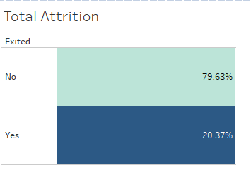
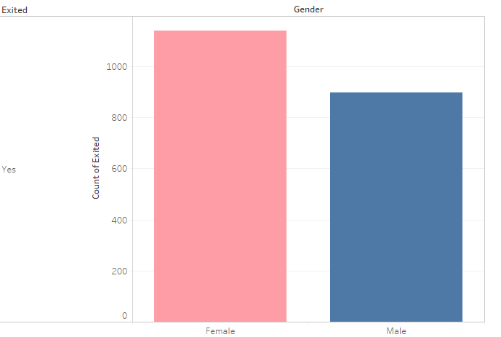
Exploratory Data Analysis
Over 20% of customers leave our bank.
Females tend to leave bank more than males

Slide 5
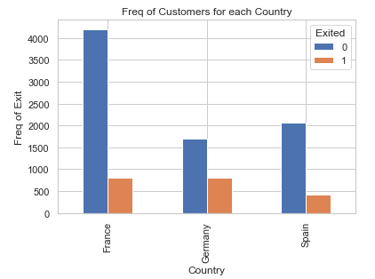
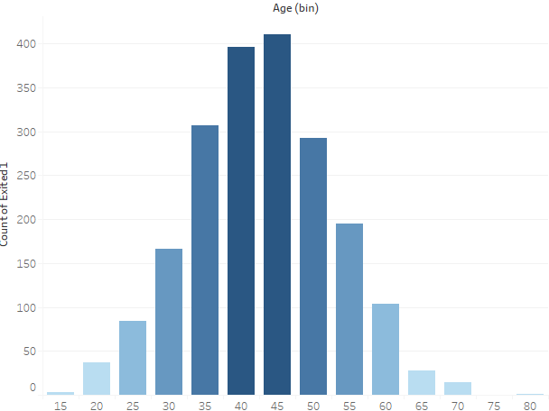
Exploratory Data Analysis
Customers in France are most prone to attrition followed by Germany followed by Spain.
Customers in age range of 40-49 tend to have highest churn rates

Slide 6

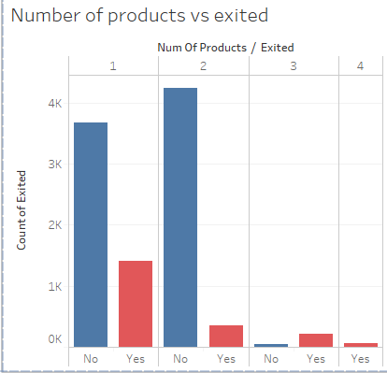
Exploratory Data Analysis
Important insight: No customer using 4 products stayed with the bank.

Slide 7

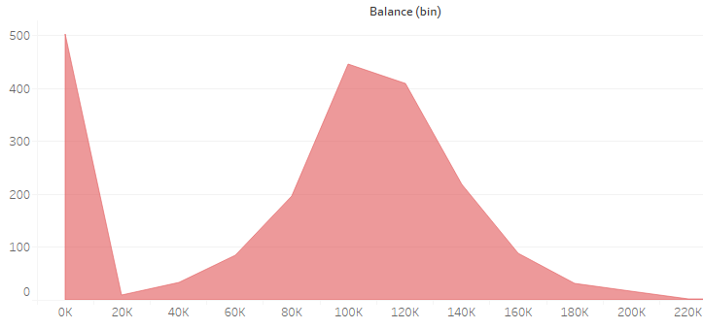
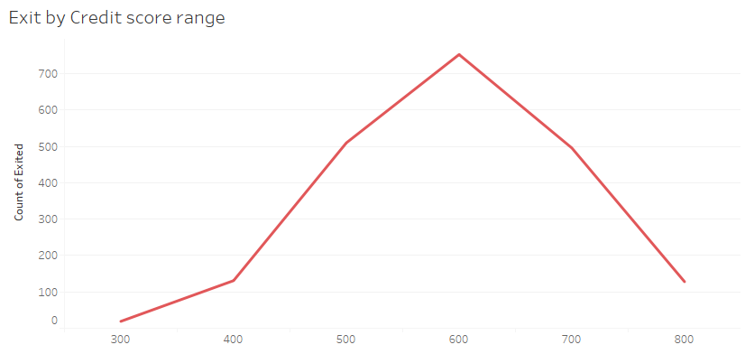
Exploratory Data Analysis
Most customers leaving the bank has monthly average balance of $80,000 - $140,000.
Additionally, attrition is high for customers with average balance lower than $20,000
People with credit score in the range of 500-700 are most prone to leaving

Slide 8
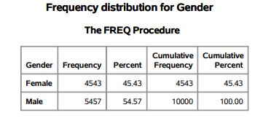
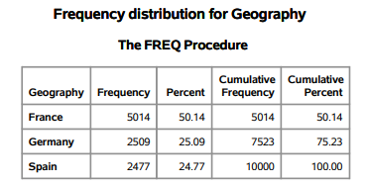
Descriptive Statistics
Dataset consist of 55% male data and 45% female data
Most customers belong to France followed by Germany and Spain

Slide 9
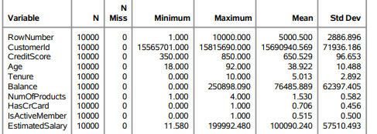
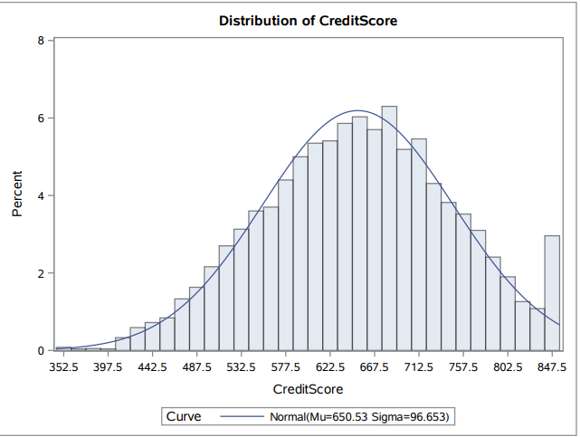
Descriptive Statistics
Huge Std. deviation and mean for Balance and Salary represents deviation from central tendencies
Most consumers have credit score of 550-700. Deviation from Central tendency can be explained here with more than 4% customers having Credit score of 847

Slide 10
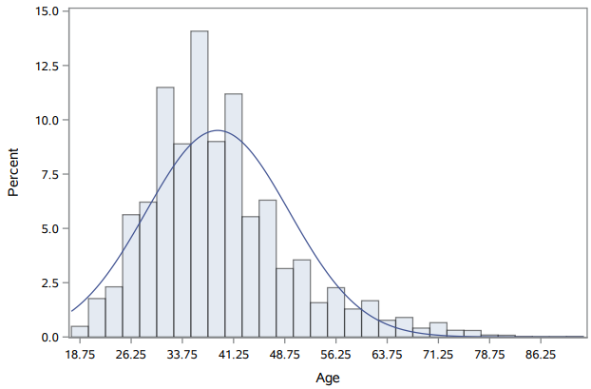
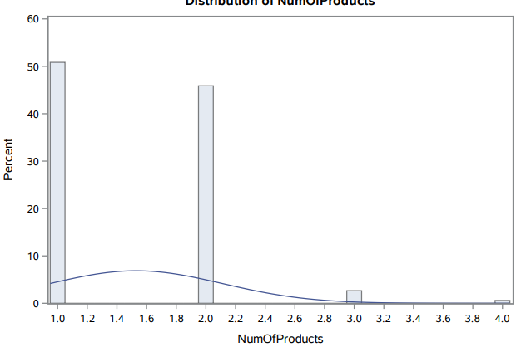
Descriptive Statistics
Median Age of customers is 37. Customers are relatively young (explained by right skewed graph)
Most consumers use 2 or less products

Slide 11
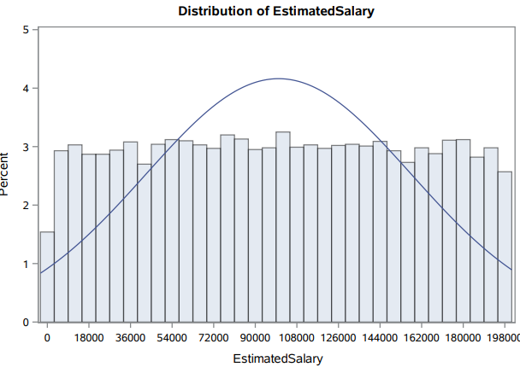
Descriptive Statistics
As per estimates most of the customers earn between $50000 to $145,000
As can be seen, the graph is evenly distributed

Slide 12
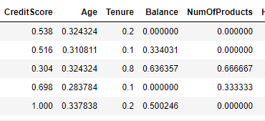
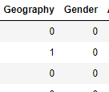
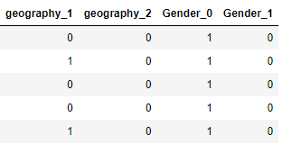
Data cleaning
In order to create a dataset which can be used by the model. Several pre-processing steps were performed.
Integer Encoding: Character variables such as Gender and Geography were converted into numerical format.
OneHotEncoding: Categorical variables then were converted into OneHot form. This is done so that model doesn’t give extra weightage to numerical values of one country over another or one gender over another.
MinMaxScaling: Reduced values to 0 to 1 to normalize the values. The goal of normalization is to change the values of numeric columns in the dataset to a common scale, without distorting differences in the ranges of values.

Slide 13
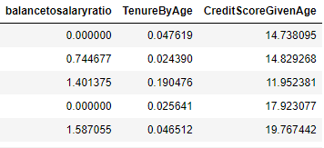
Feature Engineering
Feature engineering is the process of transforming raw data into features that better represent the underlying problem to the predictive models, resulting in improved model accuracy on unseen data.
Derived three new variables:
Balancetosalaryratio: To understand users expense vs income
TenureByAge: To understand years with bank given age.
CreditScoreGivenAge: Understand credit score vs age.

Slide 14
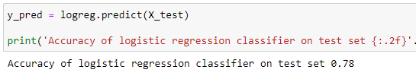
Model Building- Logistic Regression
Most defining factors that contribute to customer churn rate found in study were:
Credit Score
Age
Balance
Tenure
Gender - Female
Statistical Model:
X = 2.6*CreditScore - 1.78*Age + 1.24*Balance - 0.45*TenureByAge - + 0.55*Gender_0
Out of which Credit score, Age and Balance had the most influence. Achieved 78% accuracy
Profile - Higher credit score, Lower Age, High Balance, Female

Slide 15
Model development- Neural Network
Neural networks imitate the human brain. They use complex mathematics functions to produce results through backpropagation.
Each Neuron assigns weight to input. It perform some basic math and each neuron passes the output through activation function. This output becomes an input for next layer.
Developed ANN with 1 input layer, 2 hidden layers and 1 output layer.
Achieved an accuracy of 86%.

Slide 16
Results and Recommendations
Average balance in customers’ accounts is $76,000 ( approx.)
The Dataset of the bank churn depicts number of Male are about 54.57% and Female are 45.43%.
Females tend to leave bank more, than males.
The demographic location represents customer base:
France 50.14%,
Germany 25.09%,
Spain 24.77%.
Germany has highest attrition percentage of any country.
Customers using 4 products, or more are most prone to attrition.
Customers with Credit Score of 700-800 are most prone to join other banks.
Long-term client relations must also be established through regular alerts about personalized finance management tips and offers.
Build Campaigns around Target Customers – Offer better mortgage rates, Interest rates on Saving accs

Slide 17
Future Scope
Build Executive level dashboard to keep track of Metrics of High Impact
1
Use of predictive models( neural network ) to predict attrition and offer personalized plans
2
Develop an end-to-end prediction system with deep insight into customer behaviors
4
Upgraded Target Marketing Strategies to improve customer retention and offer real-time solutions
3

Slide 18


Thank You!

